Slide 1
Lesson 5 – Homework review

Slide 2
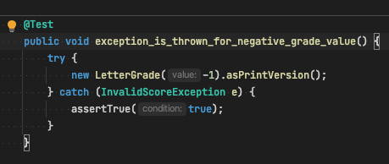
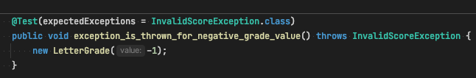
How to test Exceptions ?

Slide 3
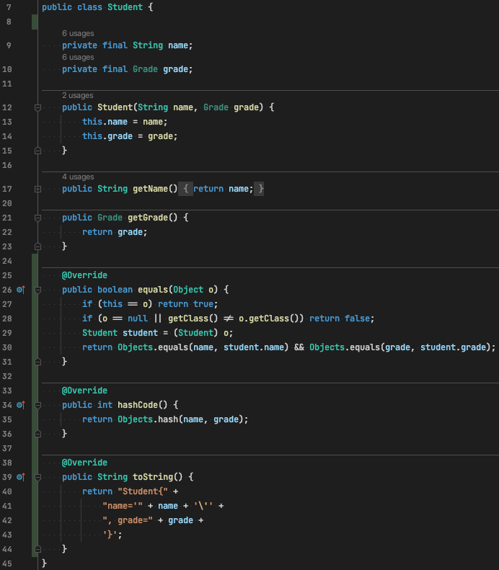
Useful methods in “Entity” classes

Slide 4
Importance of setUp methods
private StudentSorter studentSorter = new StudentSortedImpl();
vs
private StudentSorter studentSorter; @BeforeMethod public void setUp() { studentSorter = new StudentSortedImpl(); }

Slide 5
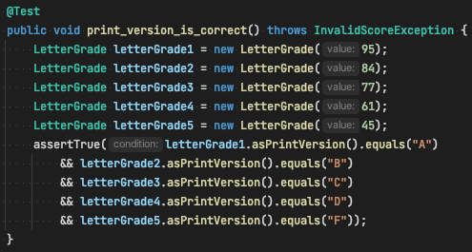
One assertion per test case

Slide 6
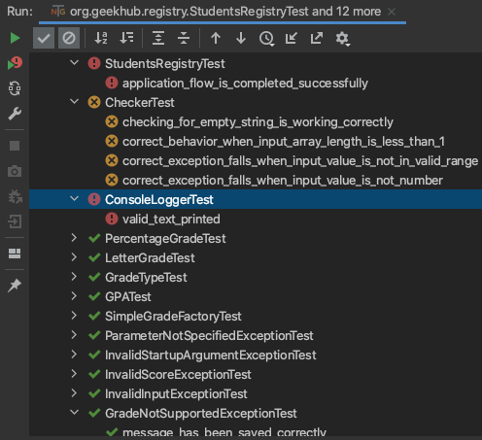
Importance of success tests

Slide 7
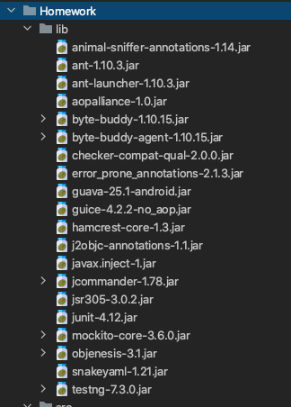
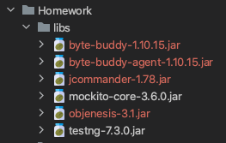
Missing/redundant JARs ???

Slide 8
Test Coverage (more in prractice part)
Cover as much as possible Business Logic code
Examples:
Each Grade implementation
Students sorter
Students filterer

Slide 9

Thanks!
Any Questions?
Or find us in Slack:
@Yaroslav Brahinets
@Vasya Rudas

